Slide 1
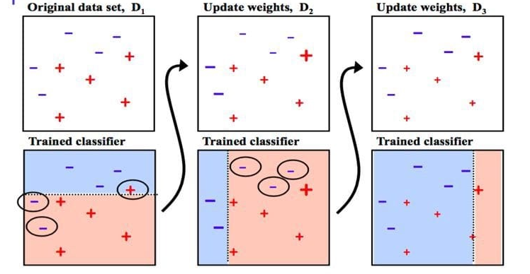
Boosting
Adaboosting

Slide 2
AdaBoost stands for Adaptive Boosting, an ensemble learning technique.
It combines multiple weak learners to form a strong predictive model.
Used in both classification and regression tasks.

Slide 3
How AdaBoost Works
1. Initialization:
- Start by assigning equal weights to all training samples.
2. Iterative Training:
- Train a weak learner (e.g., a decision tree) on the data.
- Adjust weights: Increase the weight of misclassified samples.
3. Final Model:
- Combine weak learners into a strong model by weighted voting or averaging.

Slide 4
: Key Features of AdaBoost**
Weak Learners: Typically simple models like shallow decision trees.
Weight Adjustment: Focuses on difficult-to-predict samples.
Adaptive:Continuously improves the model by adapting to errors.
Final Prediction:A weighted sum of all weak learners' predictions.

Slide 5
Advantages:
Enhances the performance of weak learners.
Effective for improving accuracy on difficult datasets.
Disadvantages:
Sensitive to noisy data and outliers.
Can overfit if the base learners are too complex or too many iterations are used.

